Slide 1
Mental Health in Complex Emergencies
“Humanitarian settings”
SOUFFRANCES D’’AUJJOURD’’HUII ET D’’AIILLEURS –
SANTE MENTALE ET MIIGRATIIONS
Lille- Grand Palais – ASPP
November 2016
Rabih El Chammay
Head of the National Mental Health Programme MOPH Lebanon
Department of Psychiatry – Faculty of Medicine- Saint Joseph University

Slide 2
Objectives
To set the frame of Mental Health in humanitarian settings
To present the Lebanon experience
To discuss the the specific challenges related to humanitarian context

Slide 3
Outline
Why?
How?
Lebanon Example
Challenges

Slide 4
Some definition before we start
Mental health?
Complex emergency?

Slide 5
Mental health
"A state of complete physical, mental and social well-being, and not merely the absence of disease".
“a state of well-being in which every individual realizes his or her own potential, can cope with the normal stresses of life, can work productively and fruitfully, and is able to make a contribution to her or his community.”

Slide 6
Complex emergency
“a humanitarian crisis in a country, region or society where there is total or considerable breakdown of authority resulting from internal or external conflict and which requires an international response that goes beyond the mandate or capacity of any single and/or ongoing UN country programme”
The term is generally used to differentiate humanitarian needs arising from conflict and instability from those that arise from natural disasters

Slide 7
Outline
Why?
How?
Lebanon Example
Challenges

Slide 8
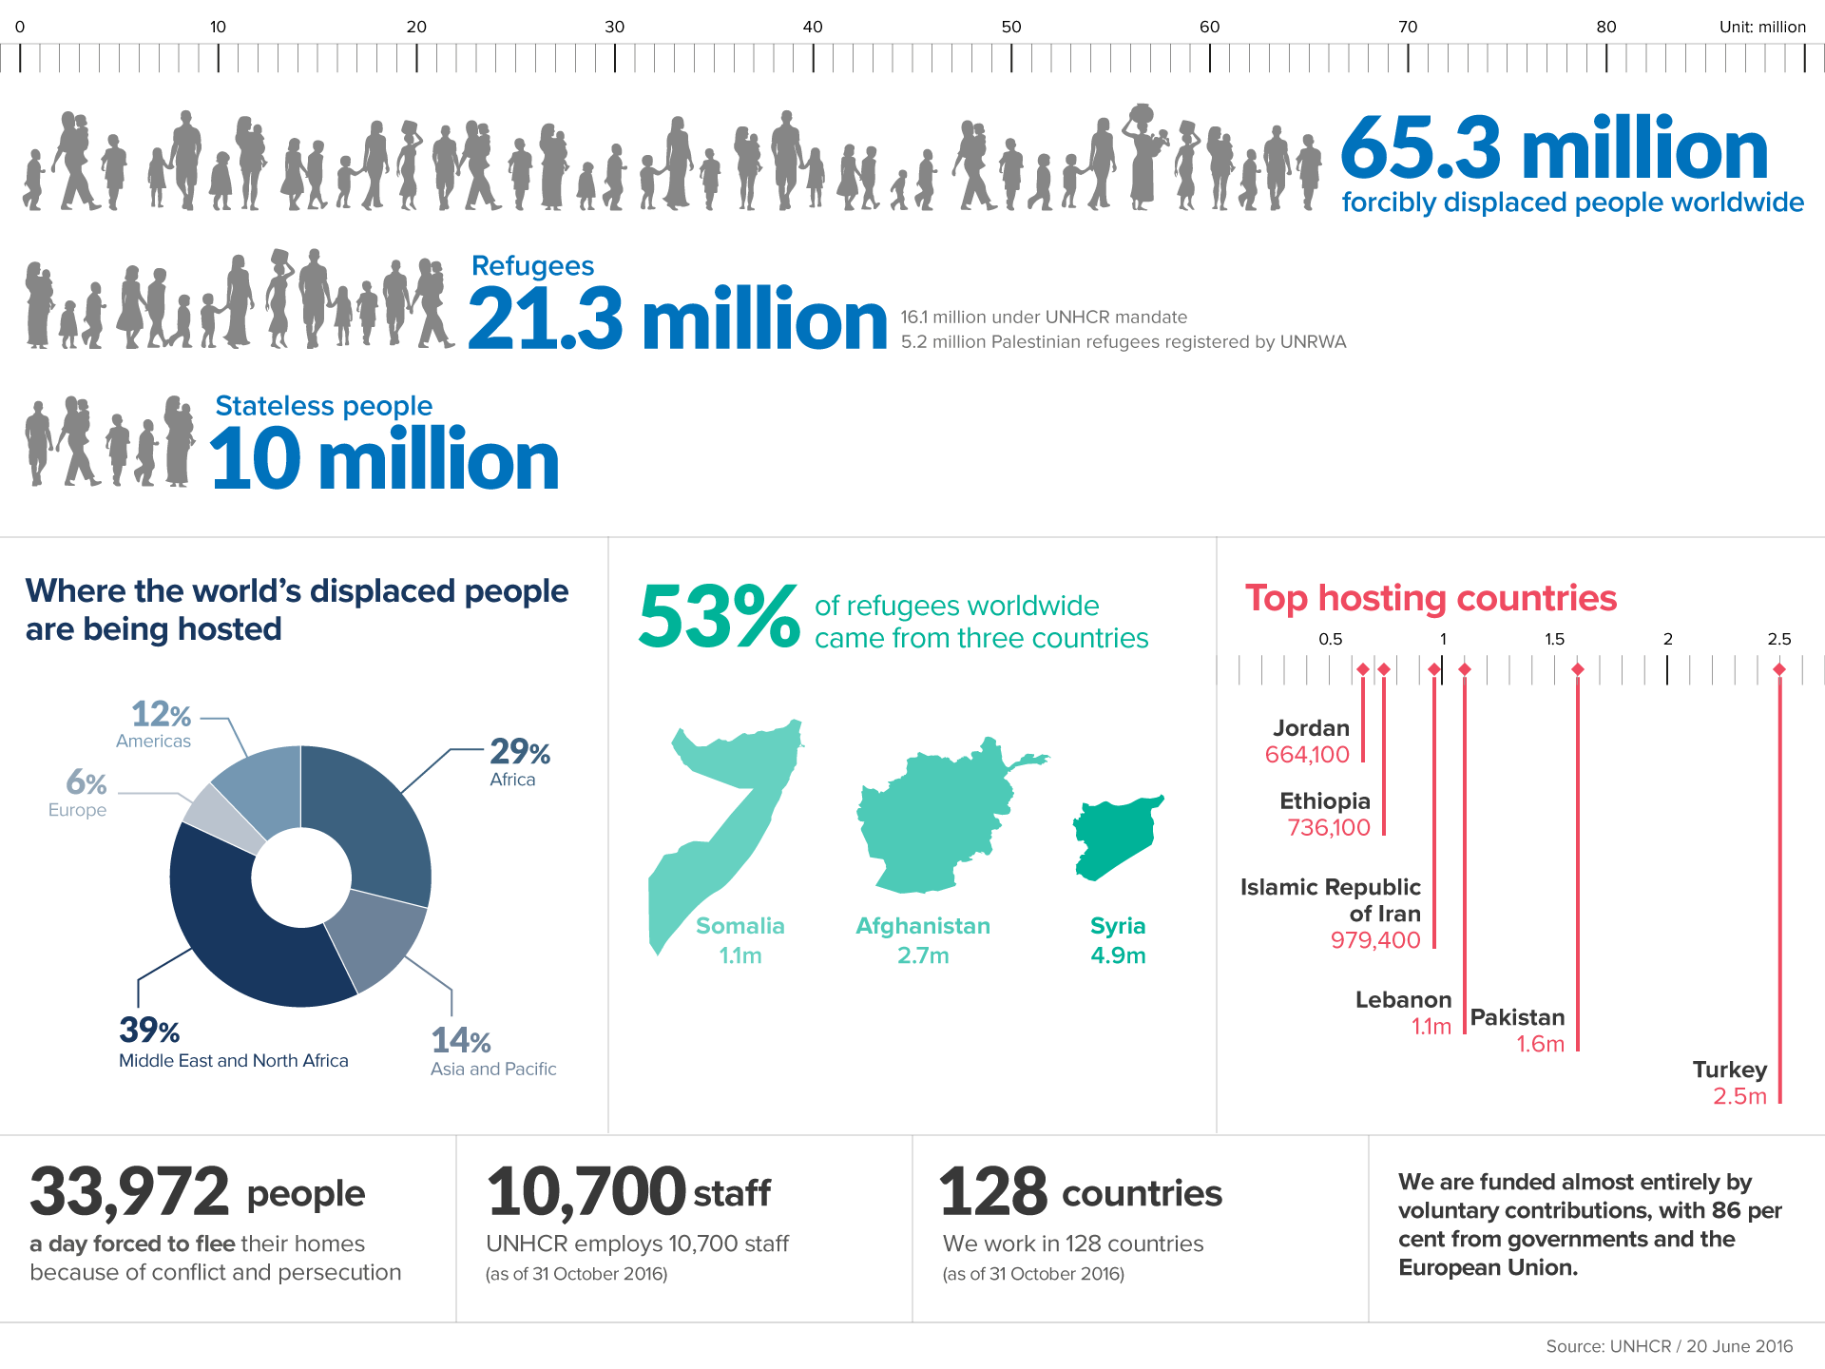

Slide 9
In complex emergencies
Persons with mental disorders are left behind
Persons affected by the emergency might be severely distressed
Persons affected by the emergency might develop mental disorders

Slide 10
Outline
Why?
How?
Lebanon Example
Challenges

Slide 11

MHPSS Guidelines http://www.who.int/mental_health/emergencies/guidelines_iasc_mental_health_psychosocial_june_2007.pdf
To establish and coordinate a set of minimum multi-sectoral responses
To protect and improve people’s mental health
To prevent and treat mental disorders
Provide short action sheets on 25 key interventions by different sectors

Slide 12
Areas of Mental Health and Psychosocial Support: All Have Impact on Protecting Well-being
Coordination
Assessment, monitoring and evaluation
Protection and human rights standards
Human resources
Community mobilization and support
Health services
Education
Dissemination of information
Food security and nutrition
Shelter and site planning
Water and sanitation

Slide 13
Mental health care by specialized mental health staff (psychiatric nurse, psychologist etc)
Trained PHC /Family doctors
Intervention pyramid
Specialized
Services
Basic mental health care by PHC workers
Basic counselling/social work by community workers
Psychological First Aid
Focused (person-to-person) non-specialized supports
Supportive child-friendly spaces
Activating social networks (e.g. through groups)
Communal traditional supports
Community and family supports
Raising community and family supports
Advocacy for basic services that are safe, socially appropriate and protect dignity
Basic services and security
Social considerations in basic services and security
Notes:
13

Slide 14
Multi-sectoral Guidance
Example: The design of sites and shelters often causes distress owing to over-crowding, lack of privacy, and lack of safety at latrines
Key Actions:
- Organize shelters in ways that promote privacy and reduce overcrowding
- Provide adequate lighting around lockable sanitation facilities

Slide 15
How Can the Guidelines Be Used?
Programme planning and design—e.g., young children
Coordinating tool
Means of identifying and avoiding the use of harmful practices
Checklist to identify gaps
Lever for advocacy supporting better practice—e.g., rights of displaced people

Slide 16
Mental health care by specialized mental health staff (psychiatric nurse, psychologist etc)
Trained PHC /Family doctors
Intervention pyramid
Specialized
Services
Basic mental health care by PHC workers
Basic counselling/social work by community workers
Psychological First Aid
Focused (person-to-person) non-specialized supports
Supportive child-friendly spaces
Activating social networks (e.g. through groups)
Communal traditional supports
Community and family supports
Raising community and family supports
Advocacy for basic services that are safe, socially appropriate and protect dignity
Basic services and security
Social considerations in basic services and security
Notes:
16

Slide 17
What comes to mind when you hear
Psychological First Aid?

Slide 18
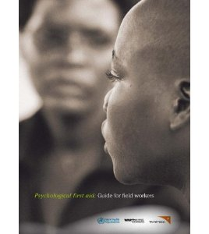
Psychological First Aid http://www.who.int/mental_health/publications/guide_field_workers/en/
A description of a humane, supportive response to a fellow human being who is suffering and who may need support

Slide 19
Psychological First Aid (PFA) is:
Providing practical care and support that does not intrude
Assessing needs and concerns
Helping people to access basic needs (e.g. food and water, information)
Comforting people and helping them to feel calm
Helping people connect to information, services and social supports
Protecting people from further harm

Slide 20
PFA is not....
It is NOT something only professionals can do
It is NOT professional counseling
It is NOT psychological debriefing
It is NOT asking someone to analyze what happened to them or to put time and events in order
It is NOT pressing people to tell you their story
It is NOT asking people details about how they
feel or what happened

Slide 21
Who is PFA for?
PFA is for very distressed people who have been recently exposed to an extremely distressing event.
It can be provided to children and adults
Not everyone who experiences a crisis event will need or want PFA. Do not force help on people who do not want it
PFA is not necessarily for everybody

Slide 22
Who needs more support than only PFA?
People with serious life-threatening injuries
People so upset they cannot care for themselves or their children
People who may hurt themselves or endanger the lives of others

Slide 23
The Action Principles of PFA
Principle | Action
LOOK | Check for safety. Check for people with obvious urgent basic needs. Check for people with serious distress reactions.
LISTEN | Approach people who may need support. Ask about people’s needs and concerns. Listen to people, and help them to feel calm.
LINK* | Help people address basic needs and access services. Help people cope with problems. Give information. Connect people with loved ones and social support.
Notes:
* Refer to the service booklet produced by IMC

Slide 24
In most situations, the following people are at special risk
Children and adolescents,
People with health conditions or physical and mental disabilities,
People at risk of discrimination or violence.

Slide 25
Mental health care by specialized mental health staff (psychiatric nurse, psychologist etc)
Trained PHC /Family doctors
Intervention pyramid
Specialized
Services
Basic mental health care by PHC workers
Basic counselling/social work by community workers
Psychological First Aid
Focused (person-to-person) non-specialized supports
Supportive child-friendly spaces
Activating social networks (e.g. through groups)
Communal traditional supports
Community and family supports
Raising community and family supports
Advocacy for basic services that are safe, socially appropriate and protect dignity
Basic services and security
Social considerations in basic services and security
Notes:
25

Slide 26
What disorders would you expect to see after a complex emergency?
Attention: Normal stress reaction
Already existing disorder in the population
Trauma induced disorders:
  Depression
  Anxiety
  Substance use
  PTSD

Slide 27
So what should we be prepared to do?
Be able to recognize normal reaction to stress
Be able to provide PFA for persons in need
Be able to assess and manage priority mental health conditions according to mhGAP-IG
Be able to identify and address complex cases to priority conditions and PTSD to specialized care.

Slide 28
Serious cases receiving no treatment during the last 12 months
80
85%
76%
70
60
50
50%
40
30
35%
20
10
0
Lower range
Upper range
Lower range
Upper range
Developed countries
Developing countries
Notes:
World Health Organization
17 November 2016
28

Slide 29
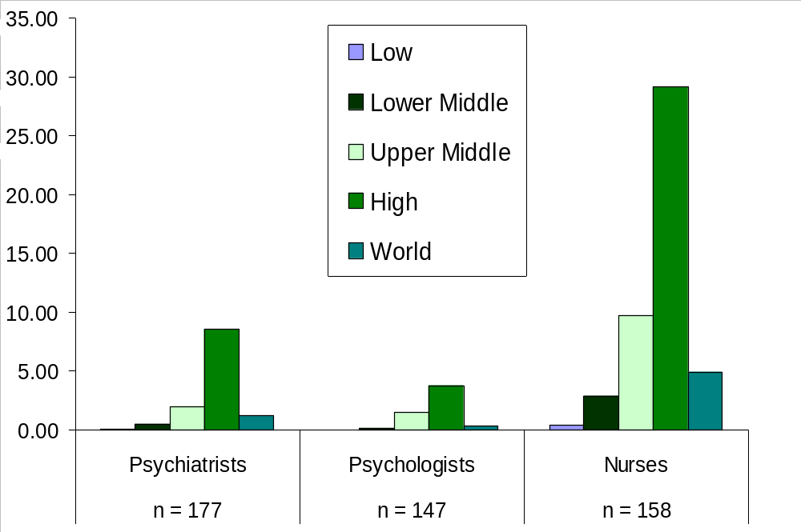
Human resources for mental health care by income group
per 100000 population

Slide 30
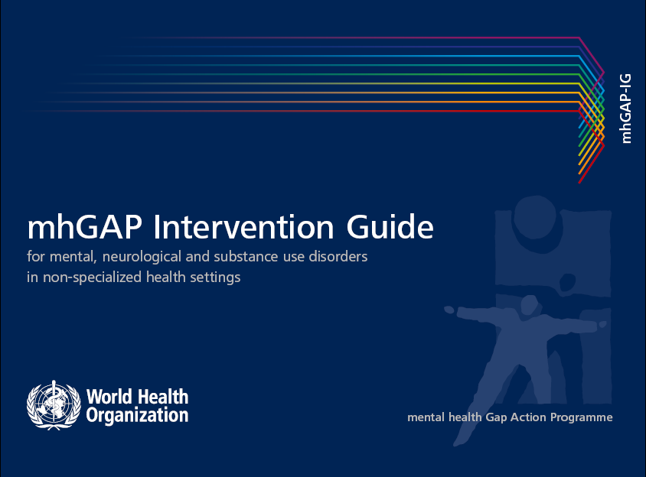
http://www.who.int/mental_health/mhgap/en/

Slide 31
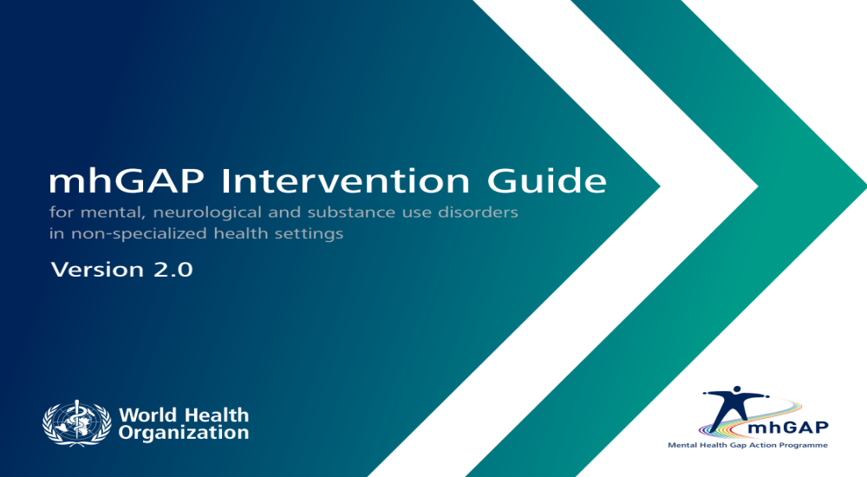
mhGAP-IG 2.0 http://apps.who.int/iris/bitstream/10665/250239/1/9789241549790-eng.pdf

Slide 32

mhGAP-IG Humanitarian version http://www.alnap.org/resource/20147

Slide 33
Who is the target audience for mhGAP-IG?
Staff not specialized in mental health or neurology
General physicians, family physicians, nurses
First point of contact and outpatient care
First level referral centers
Notes:
Explain that this guide is aimed at primary and general health care.
However, specialists also play a role in the program as supervisors.
Referral to a specialist can also be the appropriate management.

Slide 34
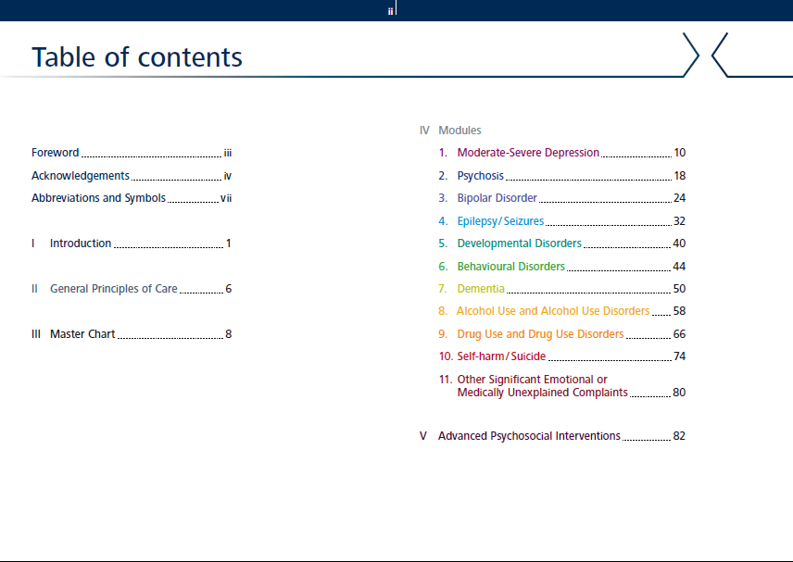

Slide 35
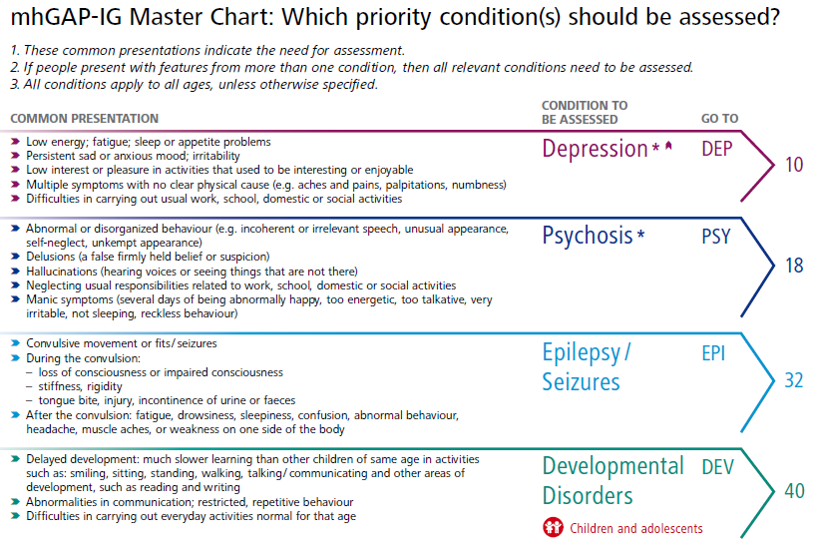
The Master Chart
Notes:
35

Slide 36
Mental health care by specialized mental health staff (psychiatric nurse, psychologist etc)
Trained PHC /Family doctors
Intervention pyramid
Specialized
Services
Basic mental health care by PHC workers
Basic counselling/social work by community workers
Psychological First Aid
Focused (person-to-person) non-specialized supports
Supportive child-friendly spaces
Activating social networks (e.g. through groups)
Communal traditional supports
Community and family supports
Raising community and family supports
Advocacy for basic services that are safe, socially appropriate and protect dignity
Basic services and security
Social considerations in basic services and security
Notes:
36

Slide 37
Specialized services
Psychiatrist
Psychologists
Psychiatric nurses
Community-based services and inpatient care
Notes:
Explain that this guide is aimed at primary and general health care.
However, specialists also play a role in the program as supervisors.
Referral to a specialist can also be the appropriate management.

Slide 38
Outline
Why?
How?
Lebanon Example
Challenges

Slide 39

Mental Health Reform in Lebanon

Slide 40
Acknowledgments
Champion
Dr. Walid Ammar
NMHP team
Founding Partners
  WHO
  UNICEF
  IMC

Slide 41
Objectives
To present the process that led to the reform
To briefly present the mental health strategy
To discuss lessons learned

Slide 42
Plan
It all got faster in 2013
Snapshot of the Mental Health System in 2014
One document for All
Human Rights a corner stone
Lessons learned

Slide 43
Plan
It all got faster in 2013
Snapshot of the Mental Health System in 2014
One document for All
Human Rights a corner stone
Lessons learned

Slide 44
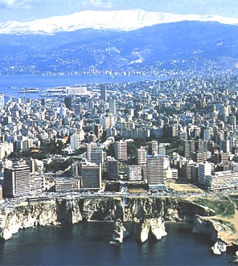
Lebanon
Eastern end of the Mediterranean sea
Area : 10, 452 Sq km
Population: 4,055,000
Palestine Refugees: 400.000
Long history of civil war and political unrest

Slide 45
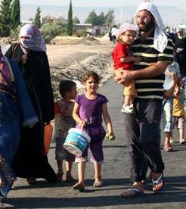
Syrian Crisis
More than 5 years
1.132.000 registered refugees in LEBANON

Slide 46
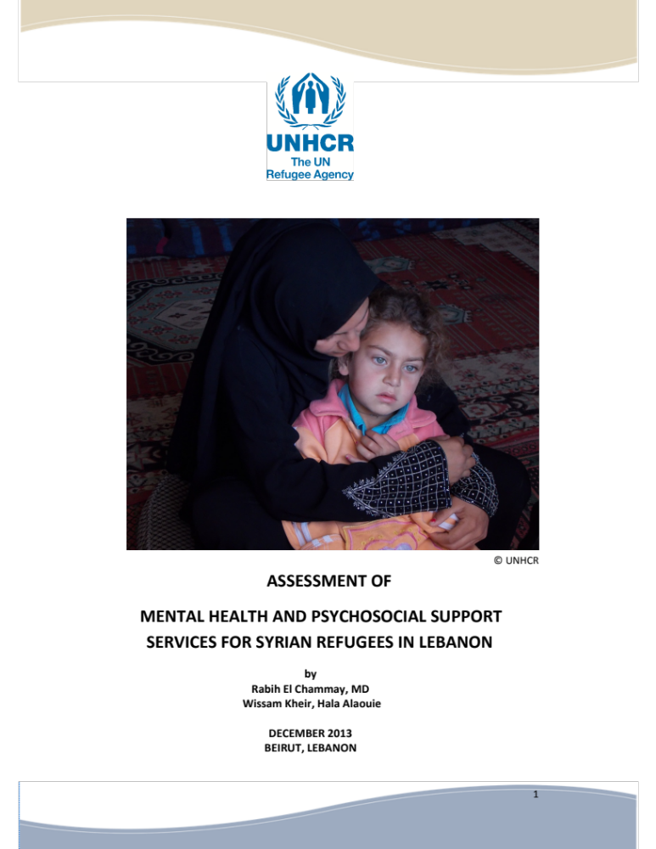
MHPSS service provision assessment https://data.unhcr.org/syrianrefugees/download.php?id=4575
Lack of coordination
Lack of MHPSS services
Weak referral System
Tension between refugees and host community
Lack of basic services is one of the main sources of distress for the refugees

Slide 47
MHPSS Task Force
Chaired by the Ministry of Public Health
Co-Chaired by WHO and UNICEF
Include 62 MHPSS actors (UN, iNGOs, NGOs, Other Ministries)
Aiming at Mainstreaming, Harmonizing and up-scaling MHPSS services in the Syrian Crisis response

Slide 48
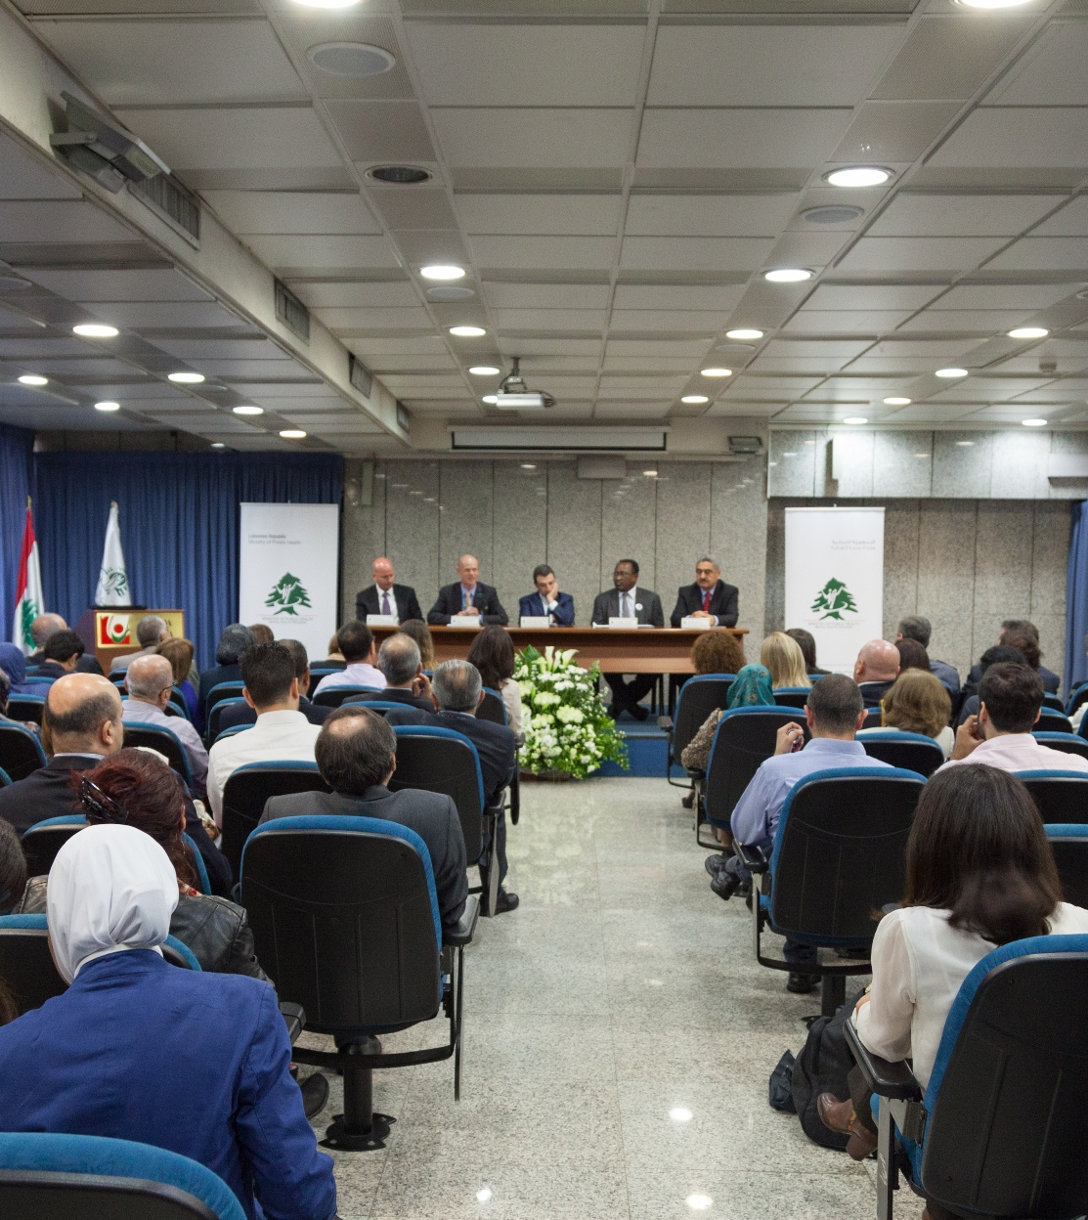
National Mental Health Program
Launched in May 2014
Supported by:
  WHO
  International Medical Corps
  UNICEF

Slide 49
Plan
It all got faster in 2013
Snapshot of the Mental Health System in 2014
One document for All
Human Rights a corner stone
Lessons learned

Slide 50
WHO AIMS 2015 http://www.emro.who.int/lbn/information-resources/
Five psychiatric hospitals
Eight psychiatric wards in general hospitals
Outpatient care mainly in the private sector
The Mental Health system is understaffed
Non-specialized are not well equipped to offer MH services
MOPH covers inpatient Care & psychotropic medication
Private insurances do not fully cover Mental Health

Slide 51
Plan
It all got faster in 2013
Snapshot of the Mental Health System in 2014
One document for All
Human Rights a corner stone
Lessons learned

Slide 52

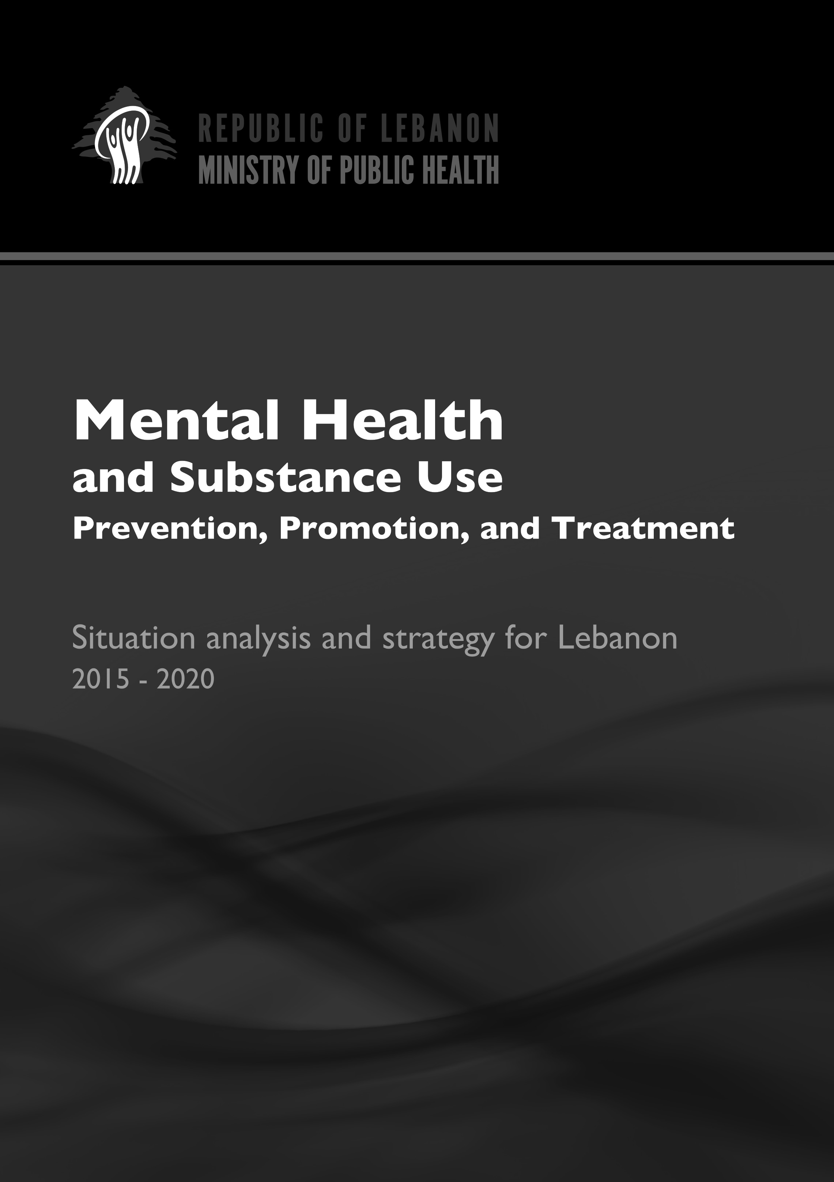
Strategy development http://www.moph.gov.lb/AboutUs/strategicplans/Pages/MentalHealthStrategy.aspx
First draft with the support of WHO in 2011
Second draft in 2014 revised by the National Mental Health Program
Third draft in 2015 after revision by local and international experts/agencies
Fourth Draft March 2015
Final Document after the national consensus
Launching in May 2015

Slide 53
Vision
“All people living in Lebanon will have the opportunity to enjoy the best possible mental health and well-being”

Slide 54
Mission
“To ensure the development of a sustainable mental health system that guarantees the universal accessibility to high quality mental health curative and preventive services through a cost-effective, evidence-based, multidisciplinary approach, with an emphasis on community involvement, continuum of care, human rights, and cultural relevance.”

Slide 55
Values
Autonomy
Dignity
Participation
Empowerment
Quality
Accountability
Integrity

Slide 56
Domains of the Strategy
Leadership and Governance
Service organization
Promotion and Prevention
HIS and Research
Vulnerable Groups

Slide 57
Vulnerable Groups
“Mental Health Does Not Discriminate”
“We mean by vulnerable groups the groups that are prone to psychological distress or mental disorders due to their circumstances.
This does not mean that persons in these vulnerable groups necessarily suffer from mental disorders but we wanted to highlight the necessity of including them in the national strategy and, in some cases, cater for their specific needs”

Slide 58
Vulnerable Groups
Children and Adolescents (MOSA, MEHE)
Foreign Domestic Workers
Older adults
Families of disappeared persons from armed conflict and war
LGBT community
Persons receiving Palliative Care
Palestinian refugees (UNRWA)

Slide 59
Vulnerable Groups
Persons living with disabilities
Persons living with HIV/AIDS
Persons in Prisons (MOI, MOJ)
Survivors of SGBV
Survivors of torture and their families
Displaced populations

Slide 60
Lessons learned
Emergencies can be an opportunity to reform mental health system
Avoid building parallel systems instead strengthen existing ones
Activate and involve local actors (MH specialists, Universities, Orders, Scientific societies)
Maximize resources by creating synergies between different organizations and agendas

Slide 61
Lessons learned
Participation should be an ongoing process not an event.
Make sure the values you work by are alive and guiding every decision
Have a plan but be ready for any emergent opportunity
Build the international network of your programme alongside your national one

Slide 62
Lessons learned
Learning by doing becomes a way of life
Start developing a taste for meetings
Sharpen your communication skills
Get enough sleep, healthy food and exercise
Make the effort to find time for your loved ones you needed as much as they do.

Slide 63
Outline
Why?
How?
Lebanon Example
Challenges

Slide 64
Can we or should de-contextualize human suffering related to war and conflicts?

Slide 65
How best to intervene with someone who threats to commit suicide if not able to access basic needs?

Slide 66
How to respond to someone asking for a report that would help them re-unit with their families?

